Slide 1
Modern Problems: Traditional Solutions
Climate Change/ Water & Food Security
FLOW: AN EXPERIENCE OF TBS
By:
Rajendra Singh,TBS

Slide 2
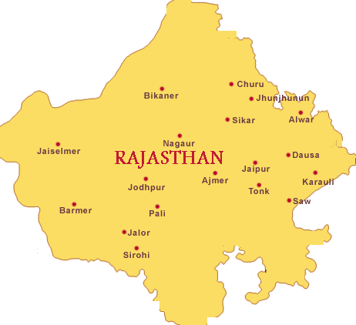
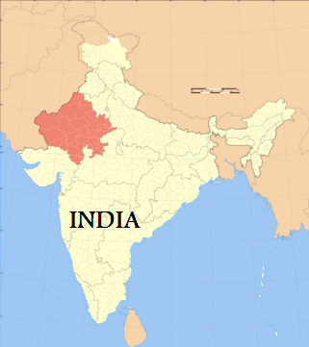
Project area of TBS
1200 villages of 19 districts of Rajasthan state of India
The major part of TBS’s work is concentrated in
600villages of district Alwar of Rajasthan.

Slide 3
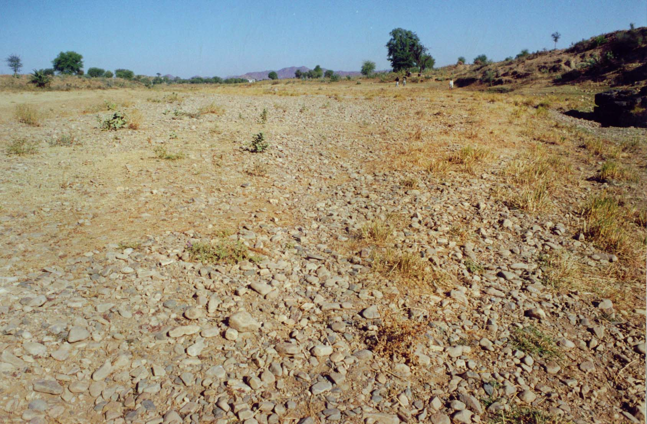
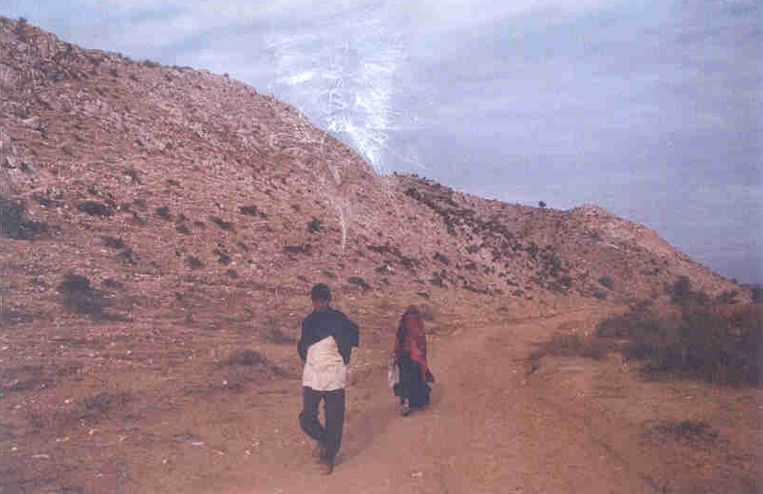
1985
Degraded and barren land
in the catchment areas of Arvari river
& extended drought
had forced people to migrate
out of their villages.

Slide 4
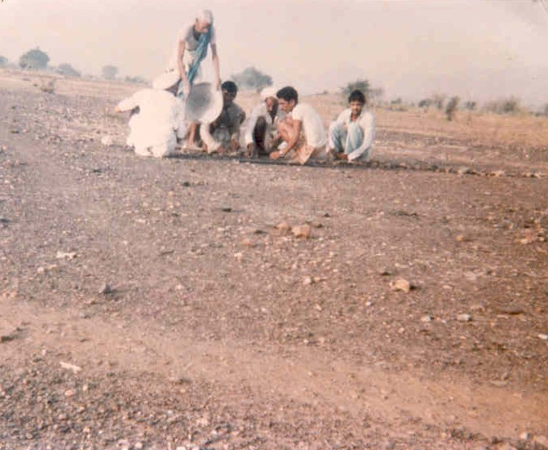
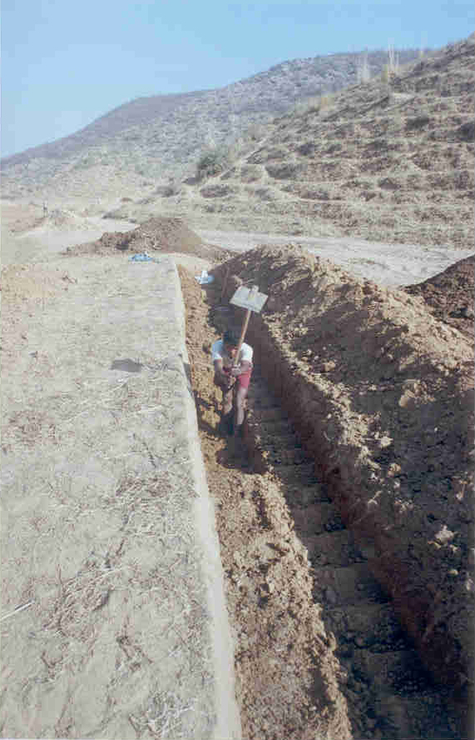
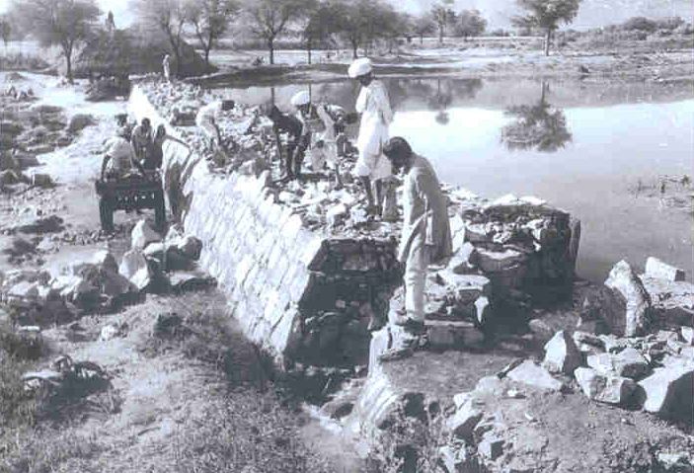
WATER harvesting structures taking shape
Johads and dams are usually built on small tributaries uphill and they directly benefit the forests on the hill.

Slide 5
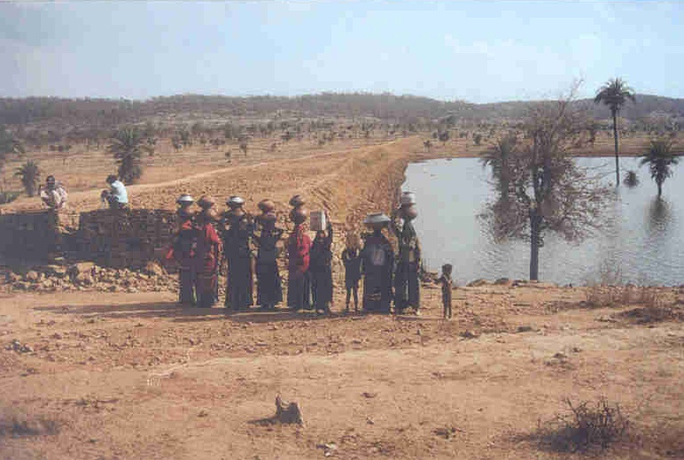
BRINGING PEOPLE TOGETHER
Success of the first Johad inspired people to take up the building of more such structures – the connection between water and forests was made and this also
led to the revival of traditional rules.
In the past, forest ownership had been taken over by the Forest Department, leading to alienation of the people and loss of traditions of conservation – making it difficult to bring people together again.

Slide 6
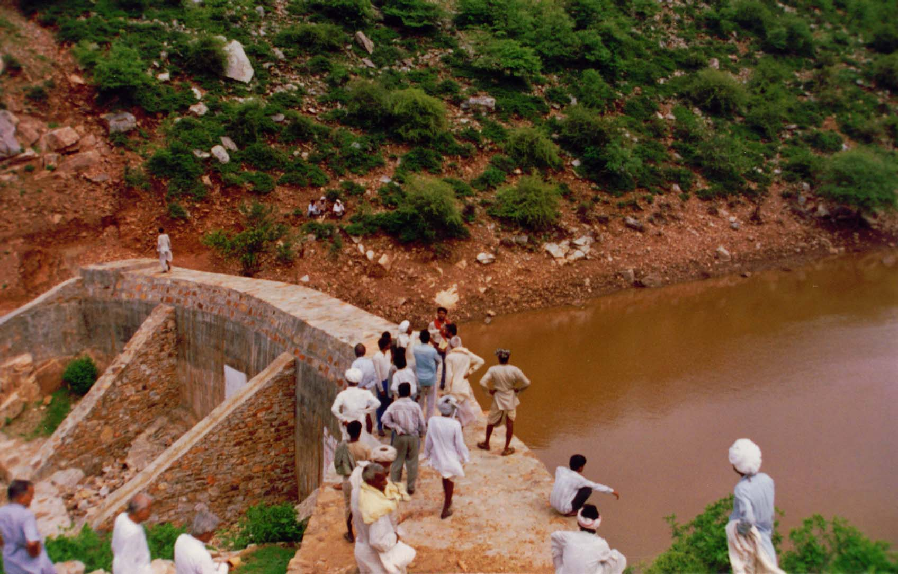
………Ideas into reality

Slide 7
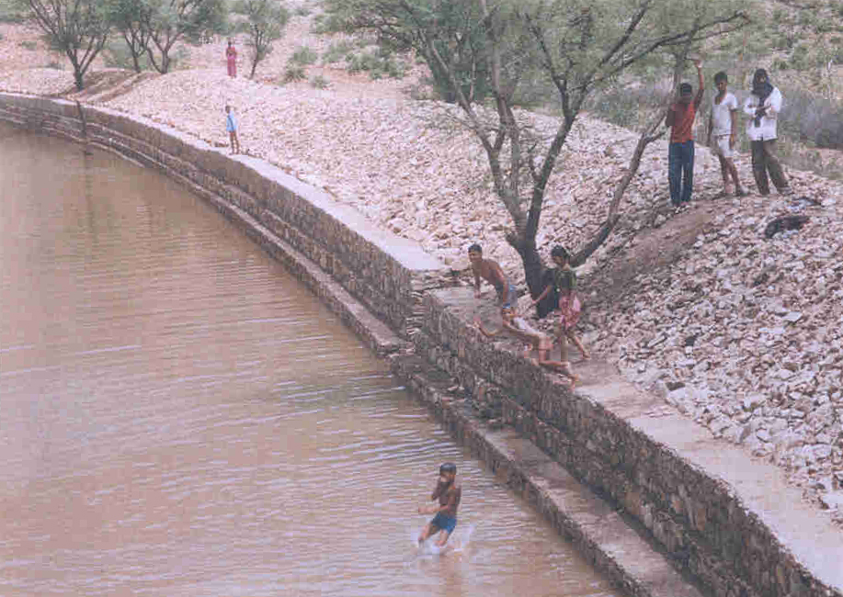
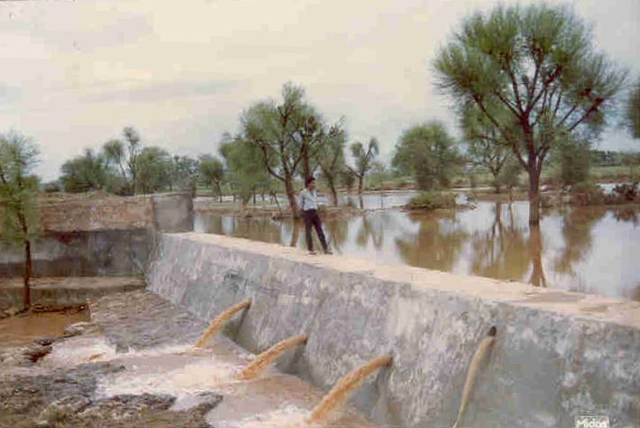
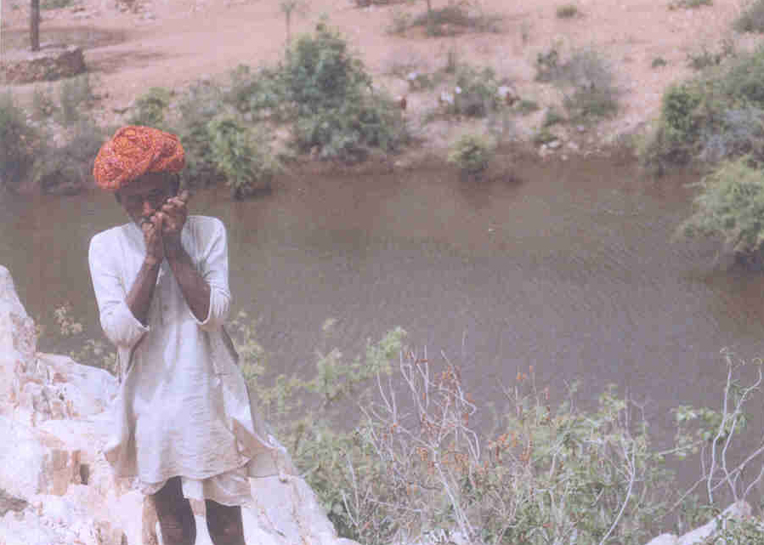
COMPLETED STRUCTURES ON Arvari BASIN

Slide 8
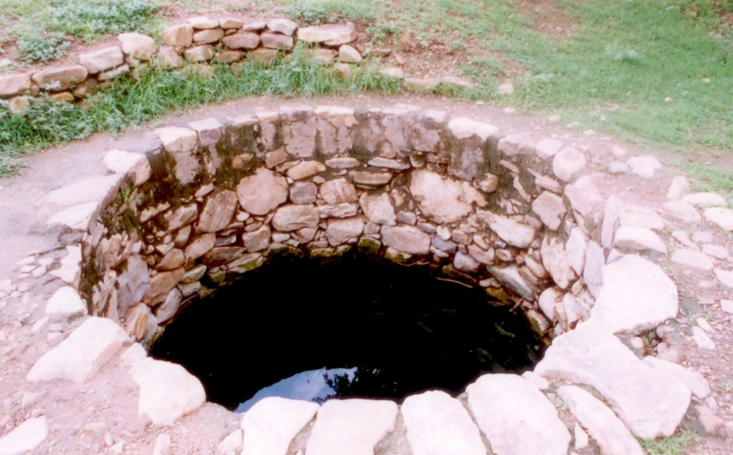
Increased water-level in a well

Slide 9
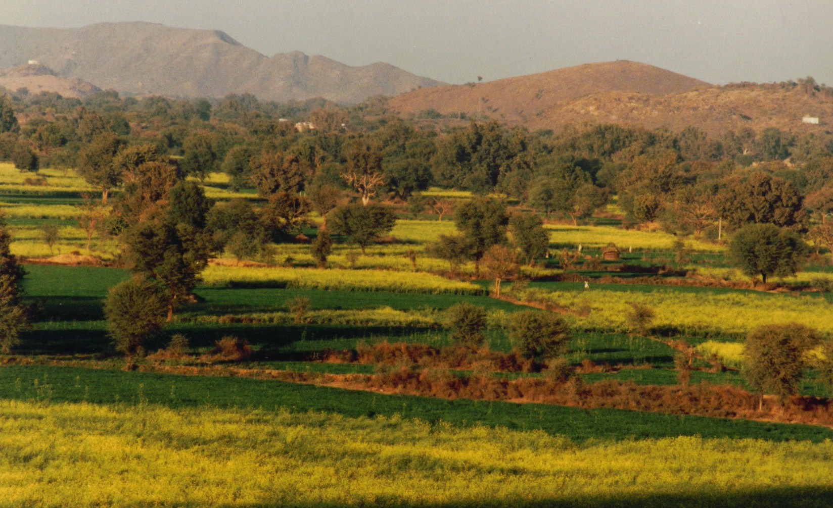
WATER for food

Slide 10
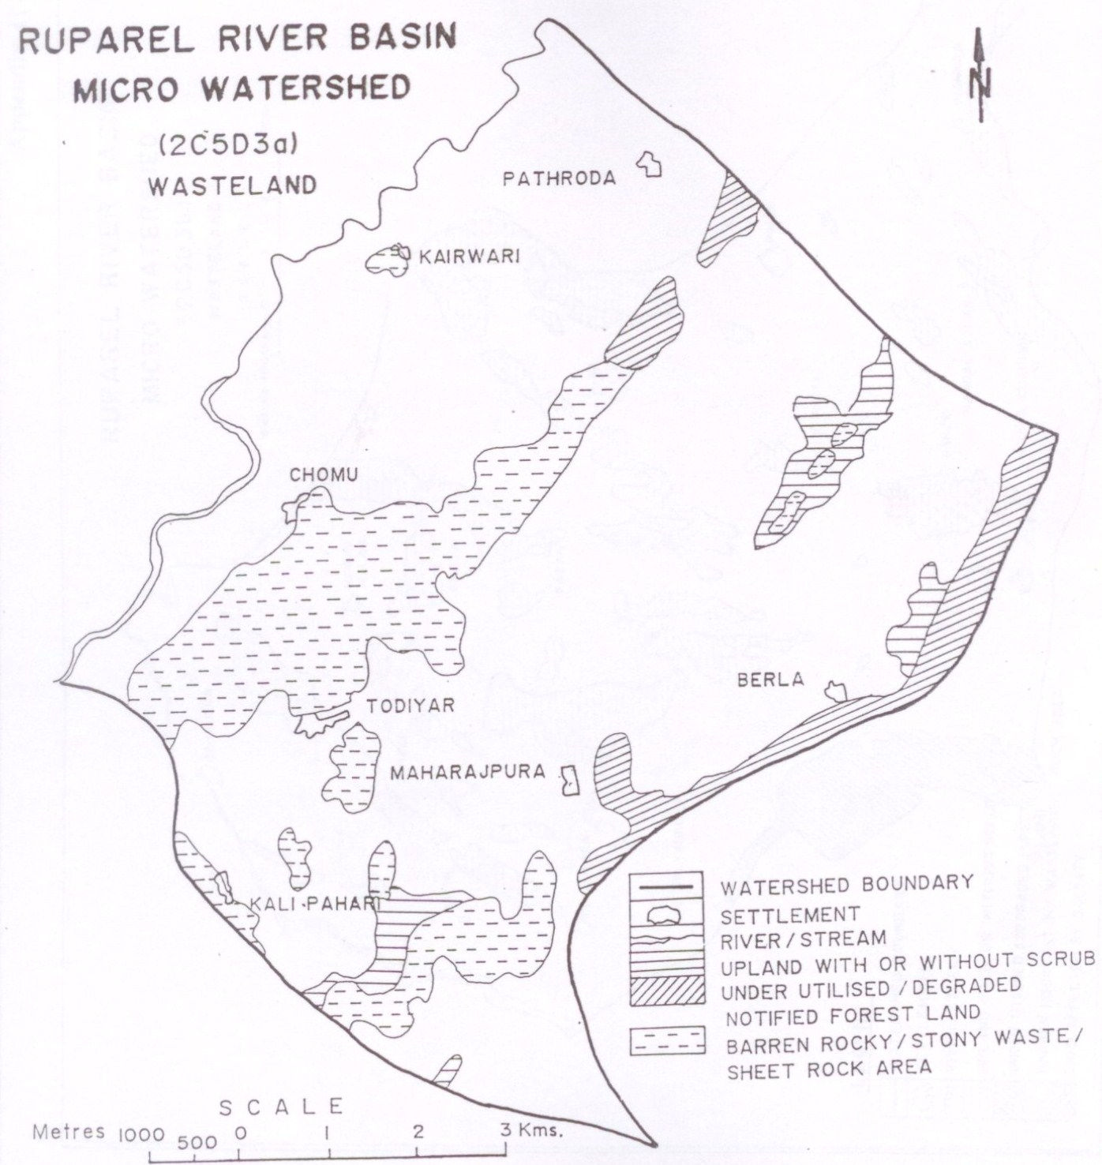
Waste land in
Ruparel River Basin
Micro-watershed:
2C 5D 3a
In 1993
Total wasteland: 1057.5 ha
Reference: A study on TBS’s works in 40 villages undertook by Dr. K.N.Joshi, Inst. of Development Studies, Jaipur

Slide 11
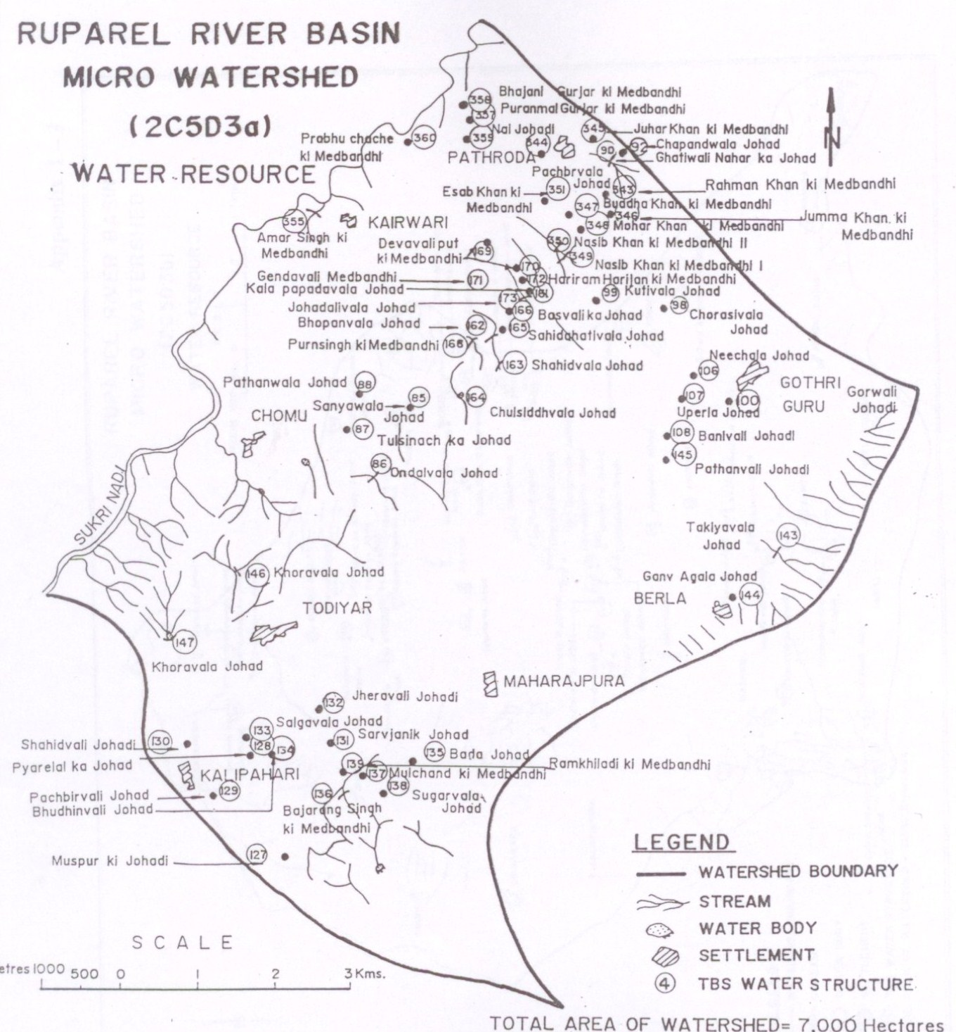
Water Resource in
Ruparel River Basin
Micro-watershed:
2C5D3a
After 1993
55 RWH structures have been built by TBS in the micro-watershed: 2C5D3a
RWH marked in the Picture.
Reference: A study on TBS’s works in 40 villages undertook by Dr. K.N.Joshi, Inst. of Development Studies, Jaipur

Slide 12
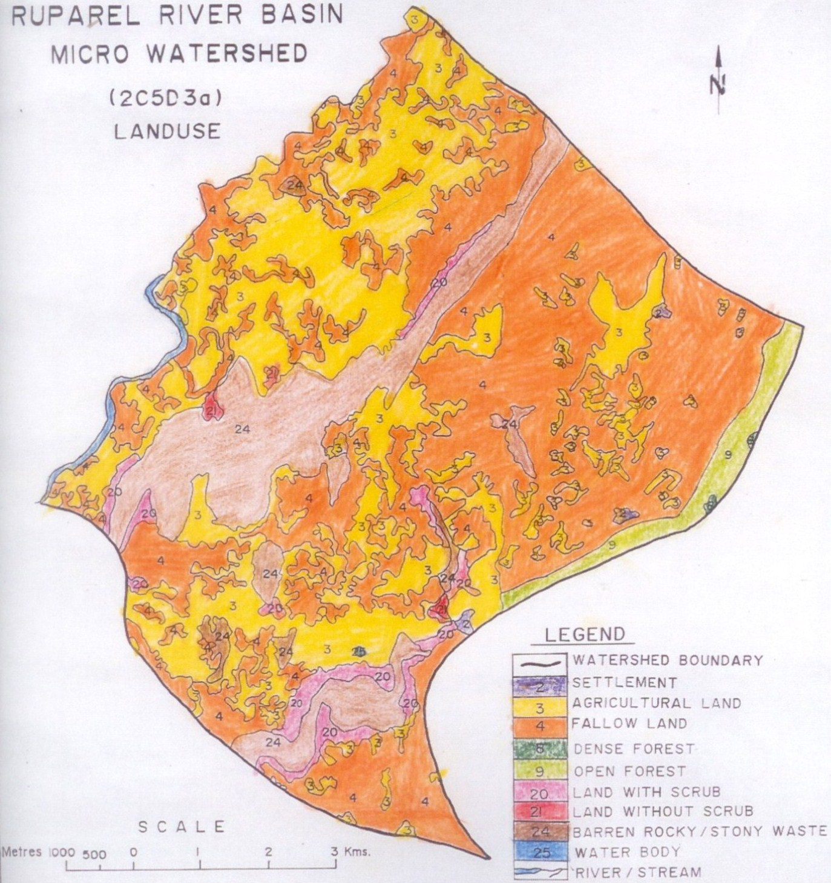
Land Use in
Ruparel River Basin
Micro-watershed:
2C 5D 3a
In 2001
Total wasteland: Nil
Most part of the land has been converted into agricultural land or seen as fallow land
Reference: A study on TBS’s works in 40 villages undertook by Dr. K.N.Joshi, Inst. of Development Studies, Jaipur.

Slide 13
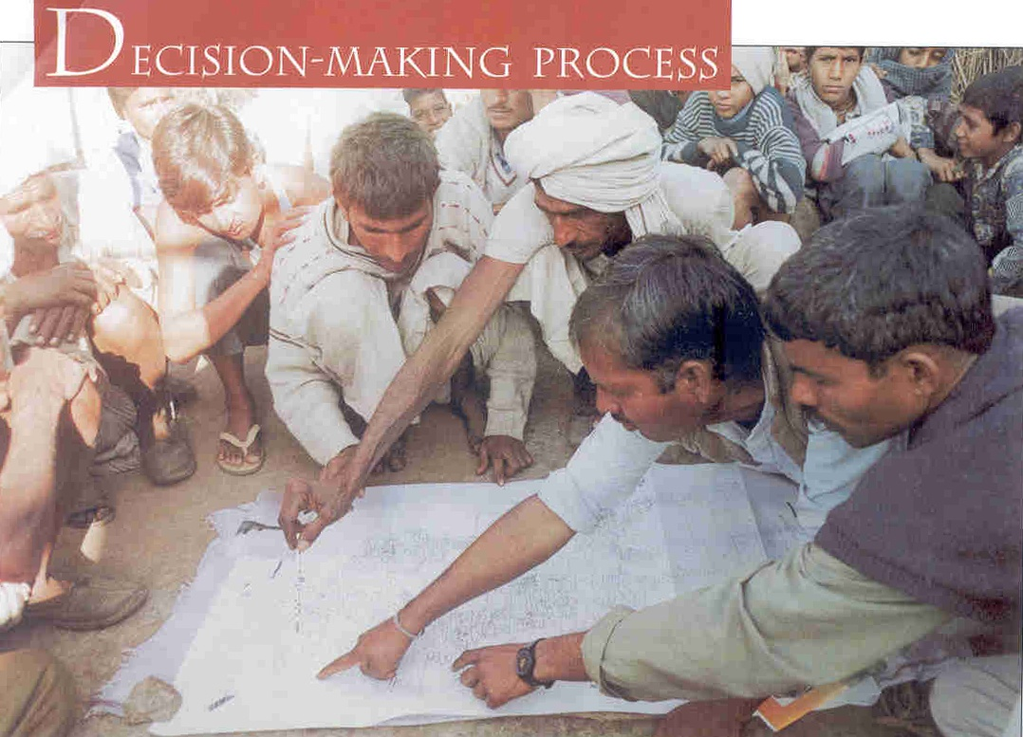
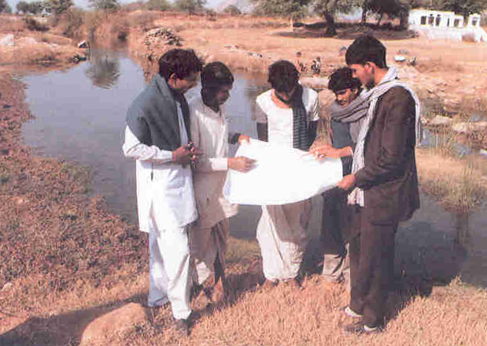
Minimum 30% of total cost was to be contributed by community for each project – the rest was to come from financial support agencies through TBS
Maximum possible use was made of people’s traditional technology and wisdom with the help and advice from engineers if needed.

Slide 14
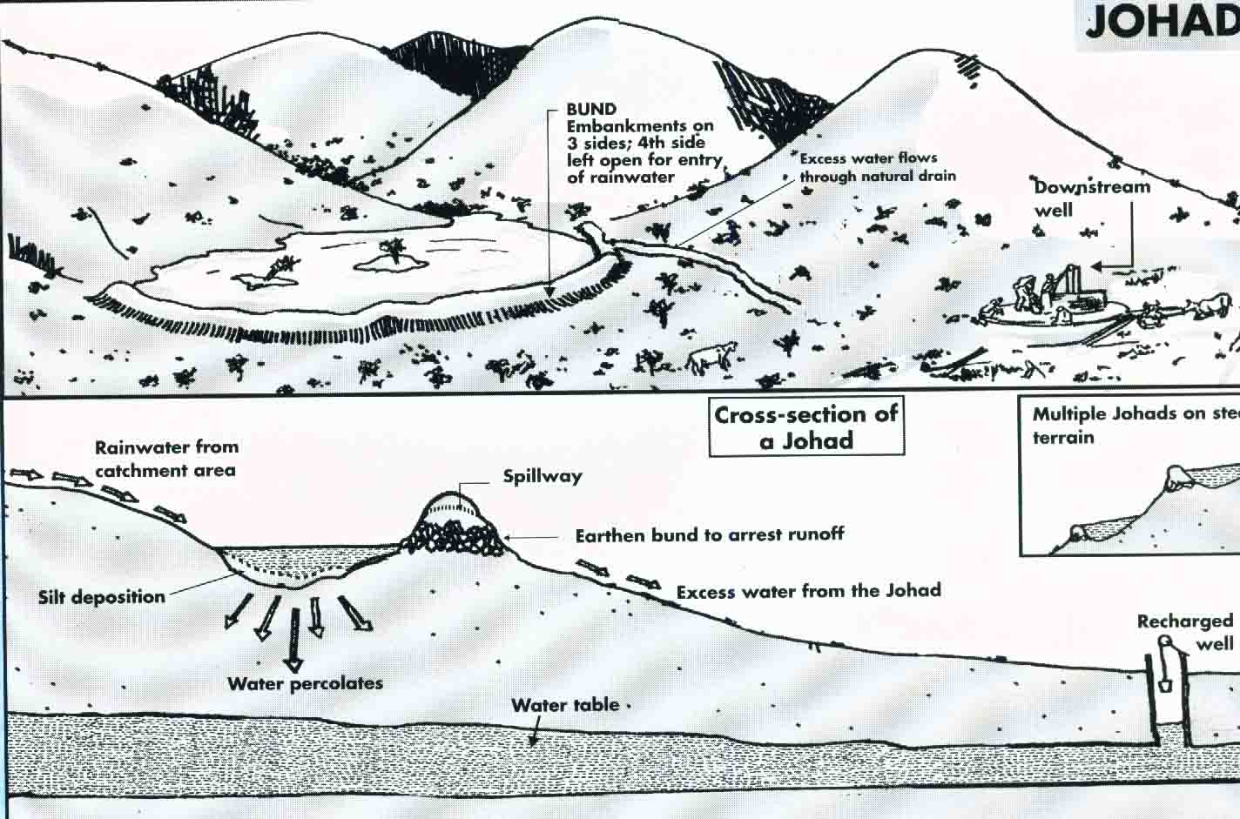
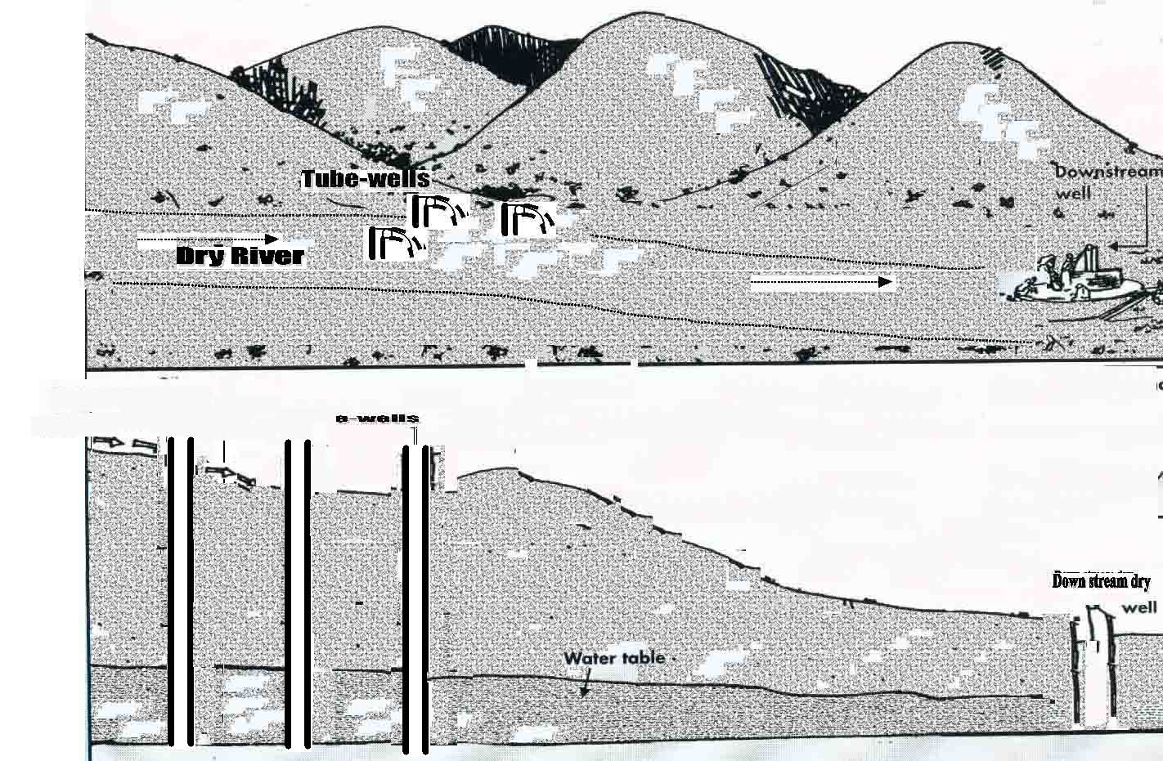
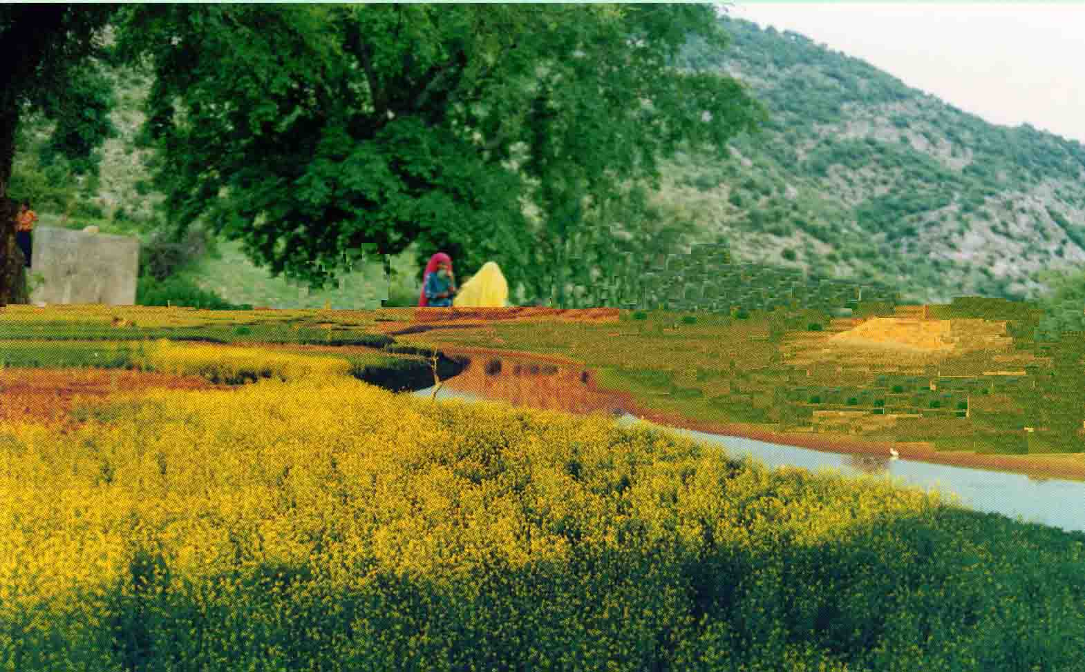
River Goes Dry:
River is flowing:
Increased Groundwater Recharge
Less Groundwater Extraction
Excess withdrawal of Groundwater

Slide 16
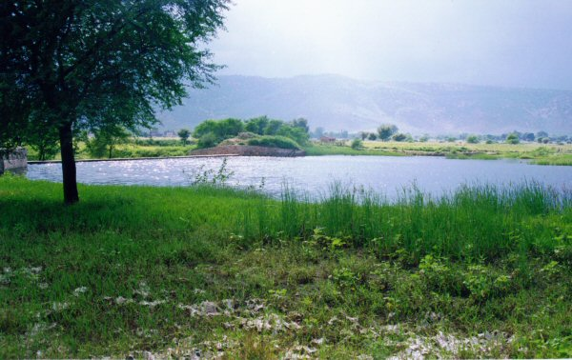
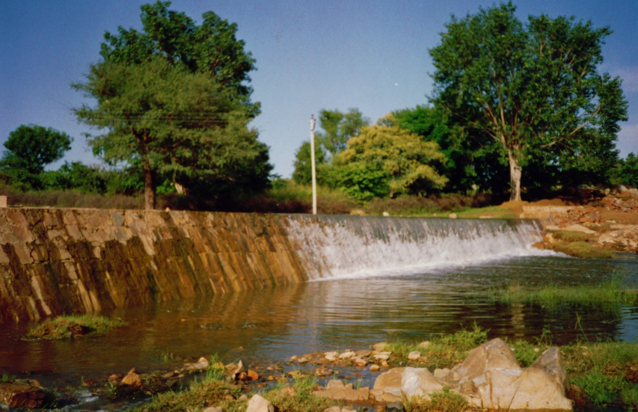
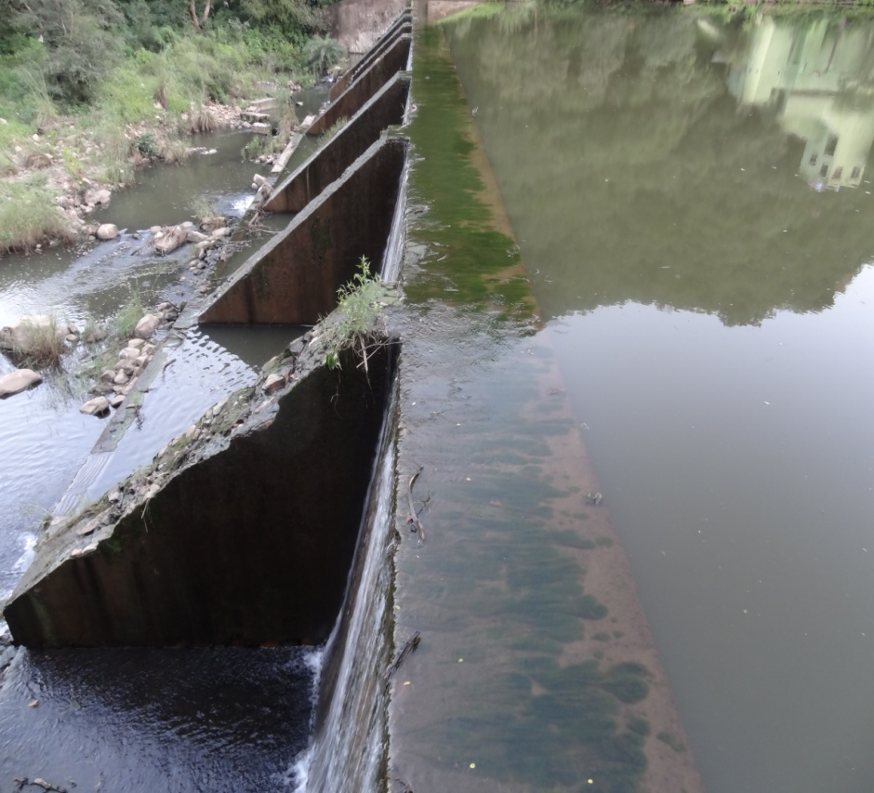

Slide 17
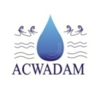
Arwari river basin: from good geology ...
Arwari basin is a compact, hydrological unit.
It has complex geology – largely crystalline rocks – mostly metamorphic rock types and with different structures.
It shows diverse fracture patterns ranging from vertical/inclined fractures in certain locations to horizontal joints in others
At least 6 distinct areas, based on hydrogeological characters can be identified...

Slide 18
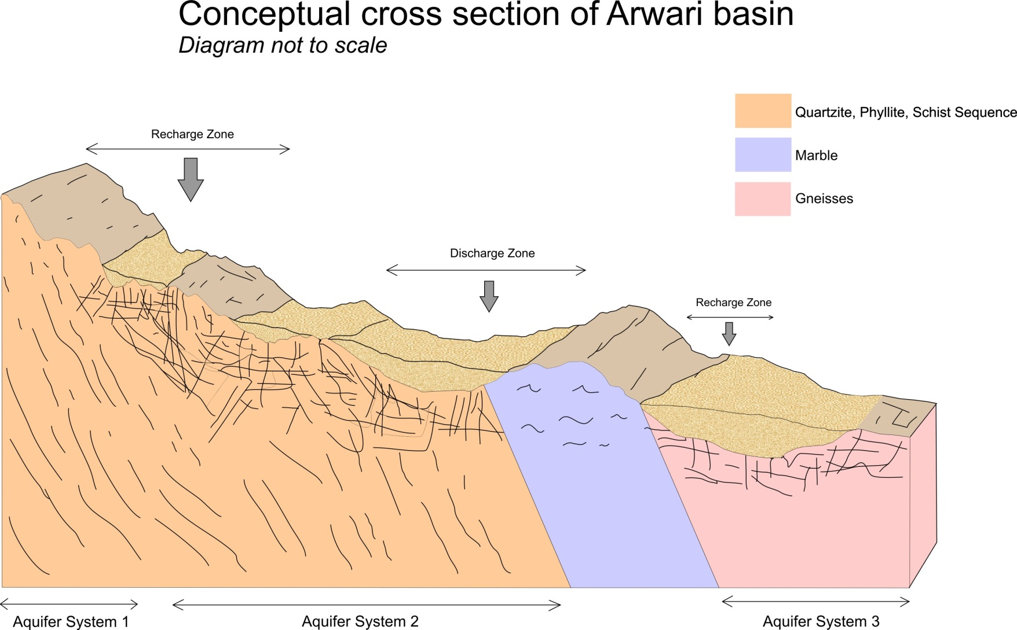
Simplified geological section

Slide 19
... to understanding groundwater conditions: typology
1: Silt atop fractured quartzites, deep wls, good to moderate yield.
2: Thick alluvium atop fractured rocks, wls at 10m, very good yield.
3: Thin silt layer resting on top of impermeable rocks, wls at 10m,
limited yield.
4: Foliated rocks, with patchy alluvium, wl is shallow but yield is limited.
5: Mining area, hard-impermeable rocks, local groundwater and limited yield.
6: Granitic-gneissic terrain, weathered and fractured aquifers, shallow wls but limited and variable yield.

Slide 20
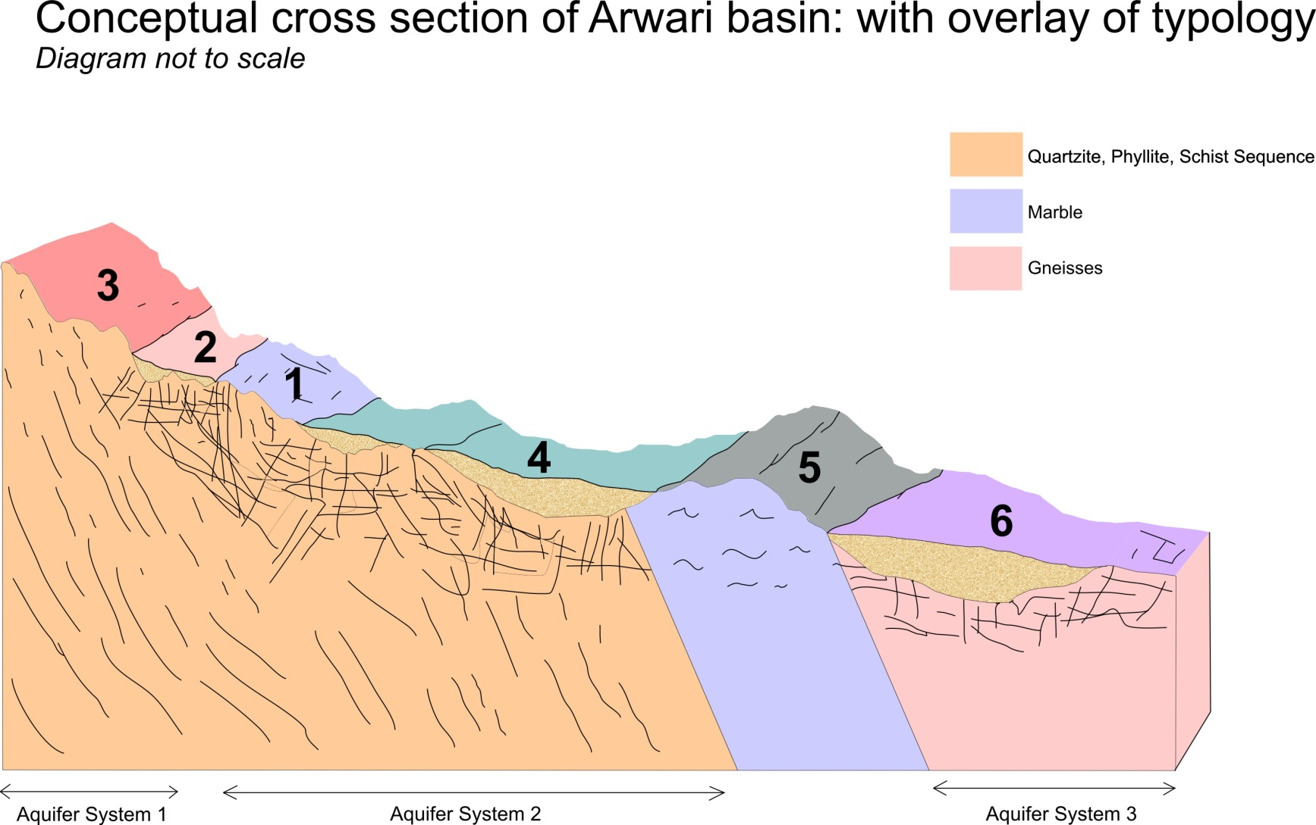
Typology and geology

Slide 21
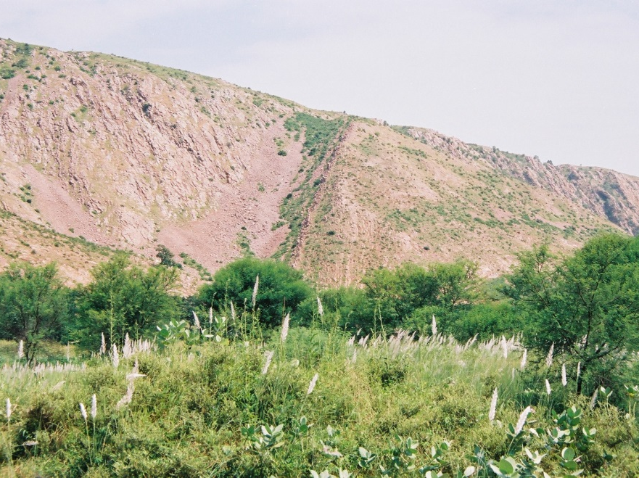
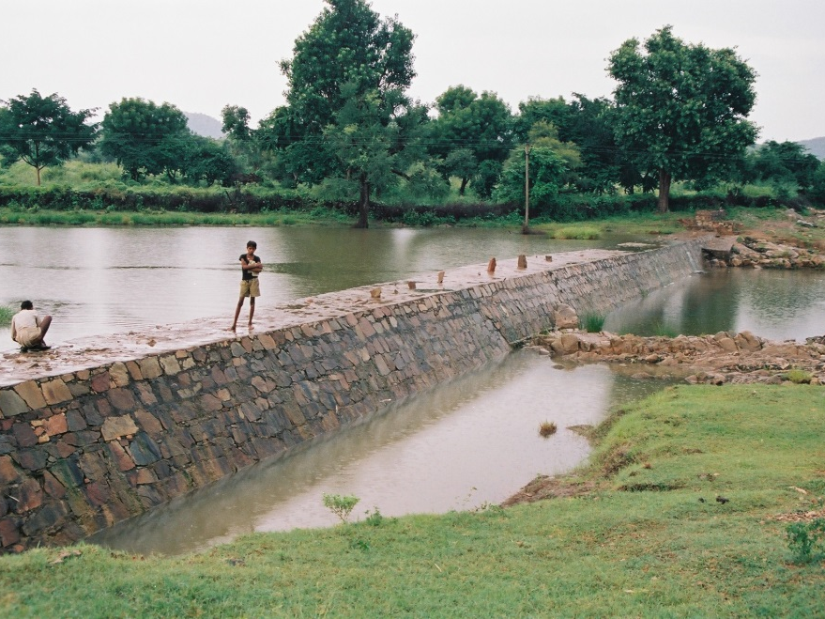
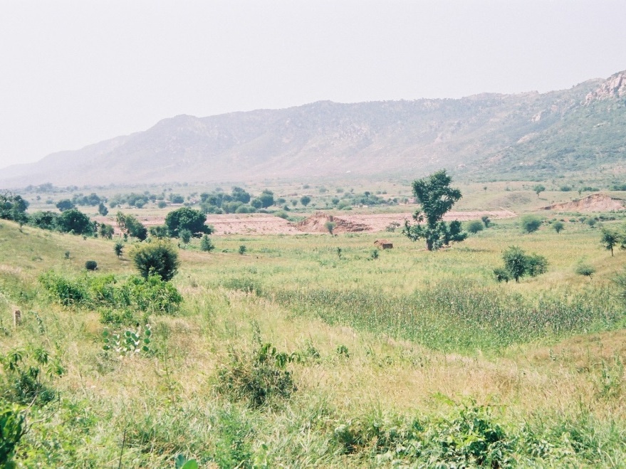
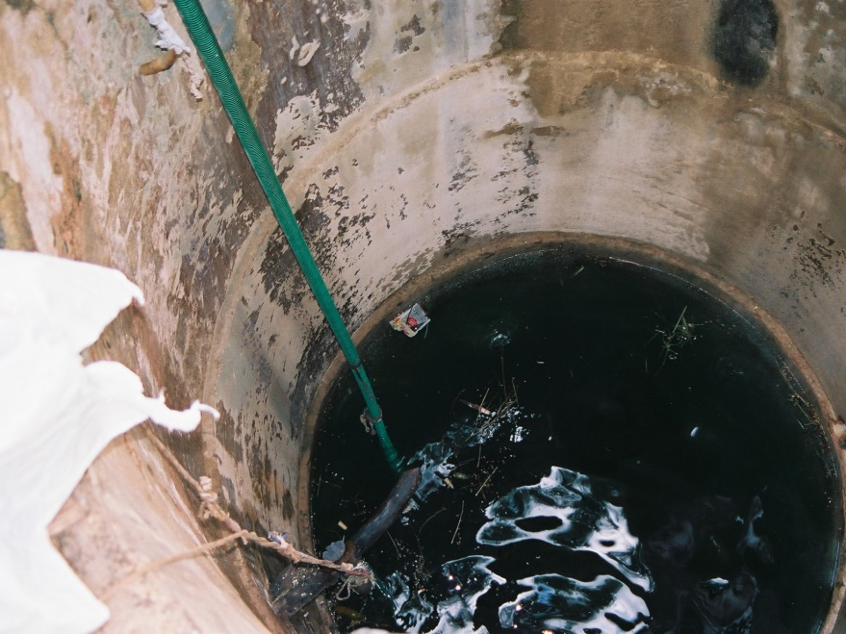

Slide 22
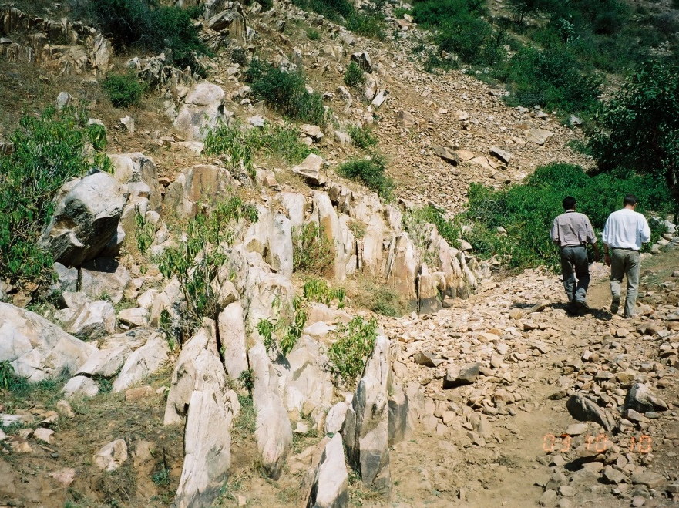
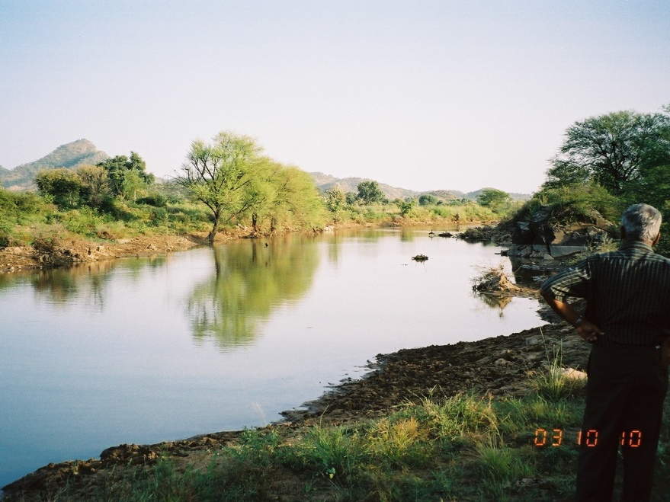
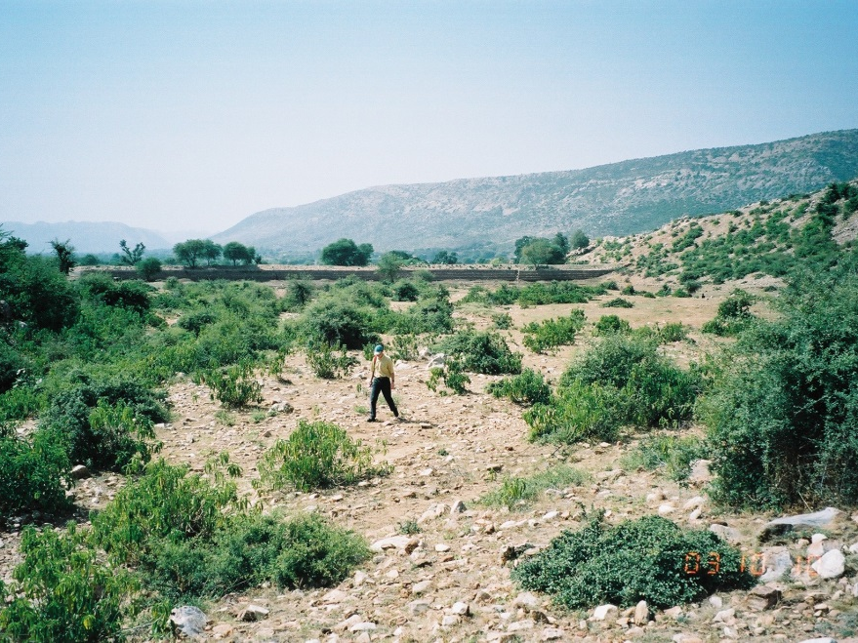
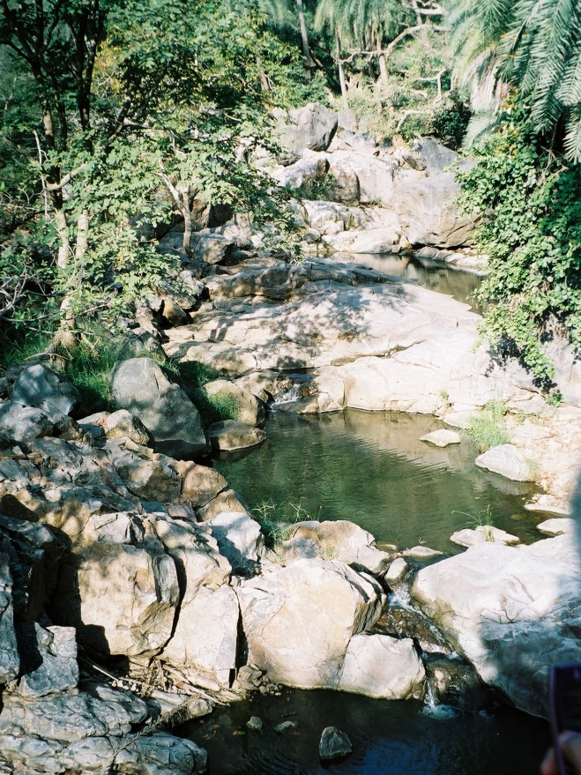

Slide 23
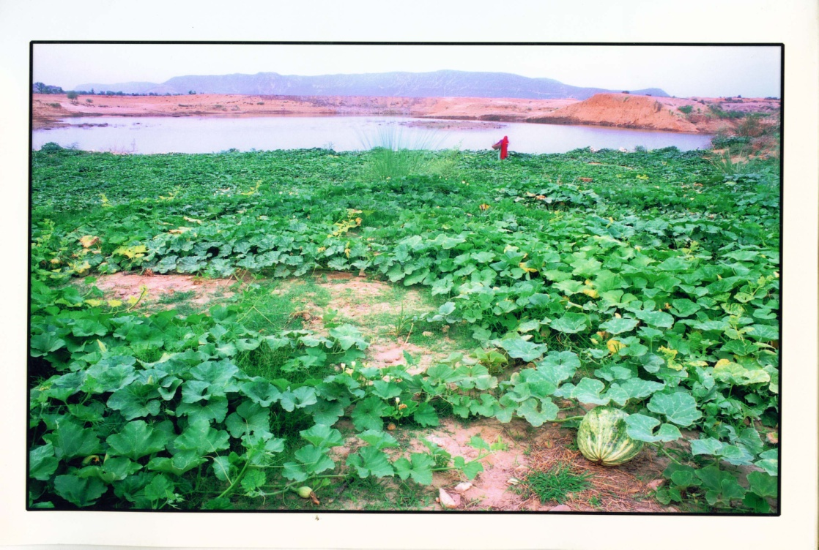
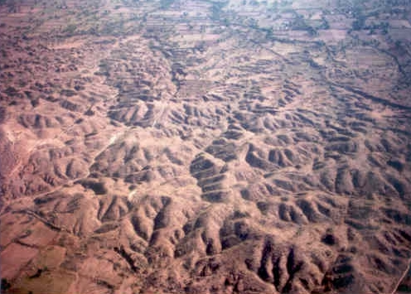
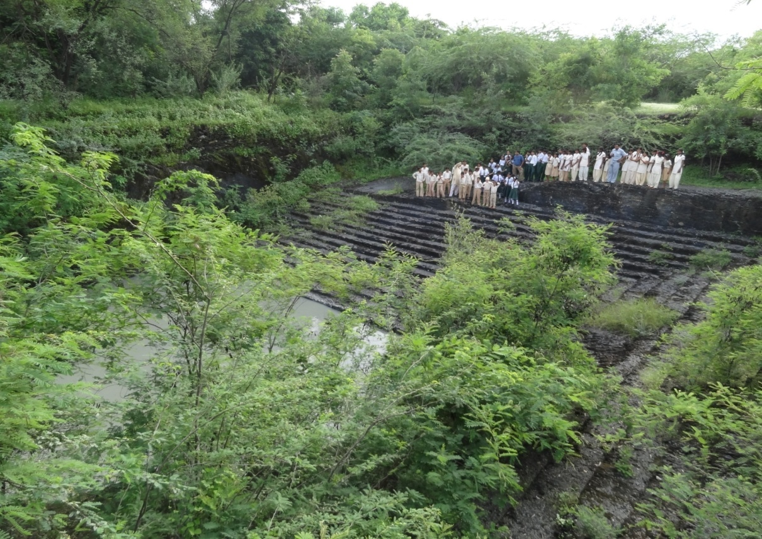
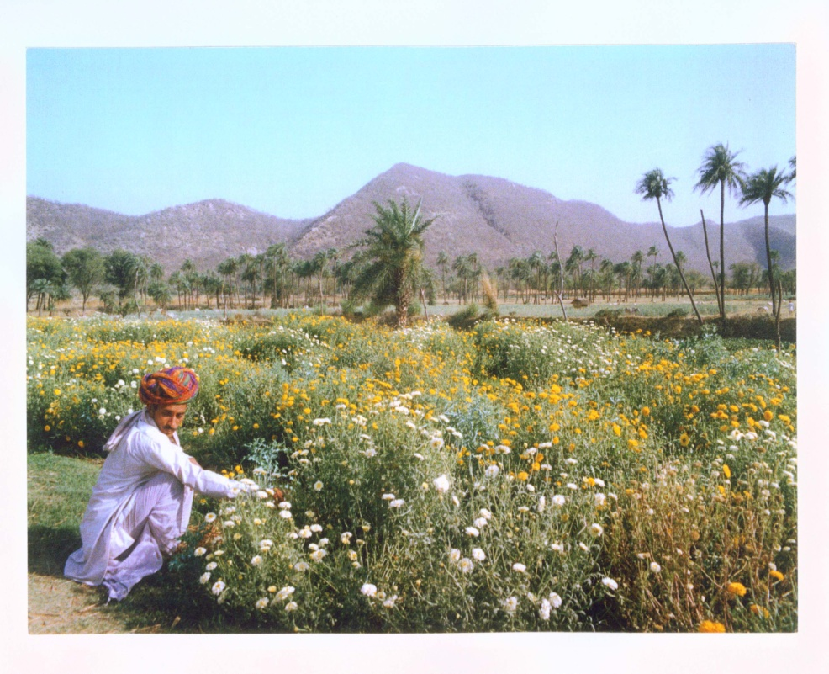
THE SITUATION IN
1985
1985
2012
2012

Slide 24
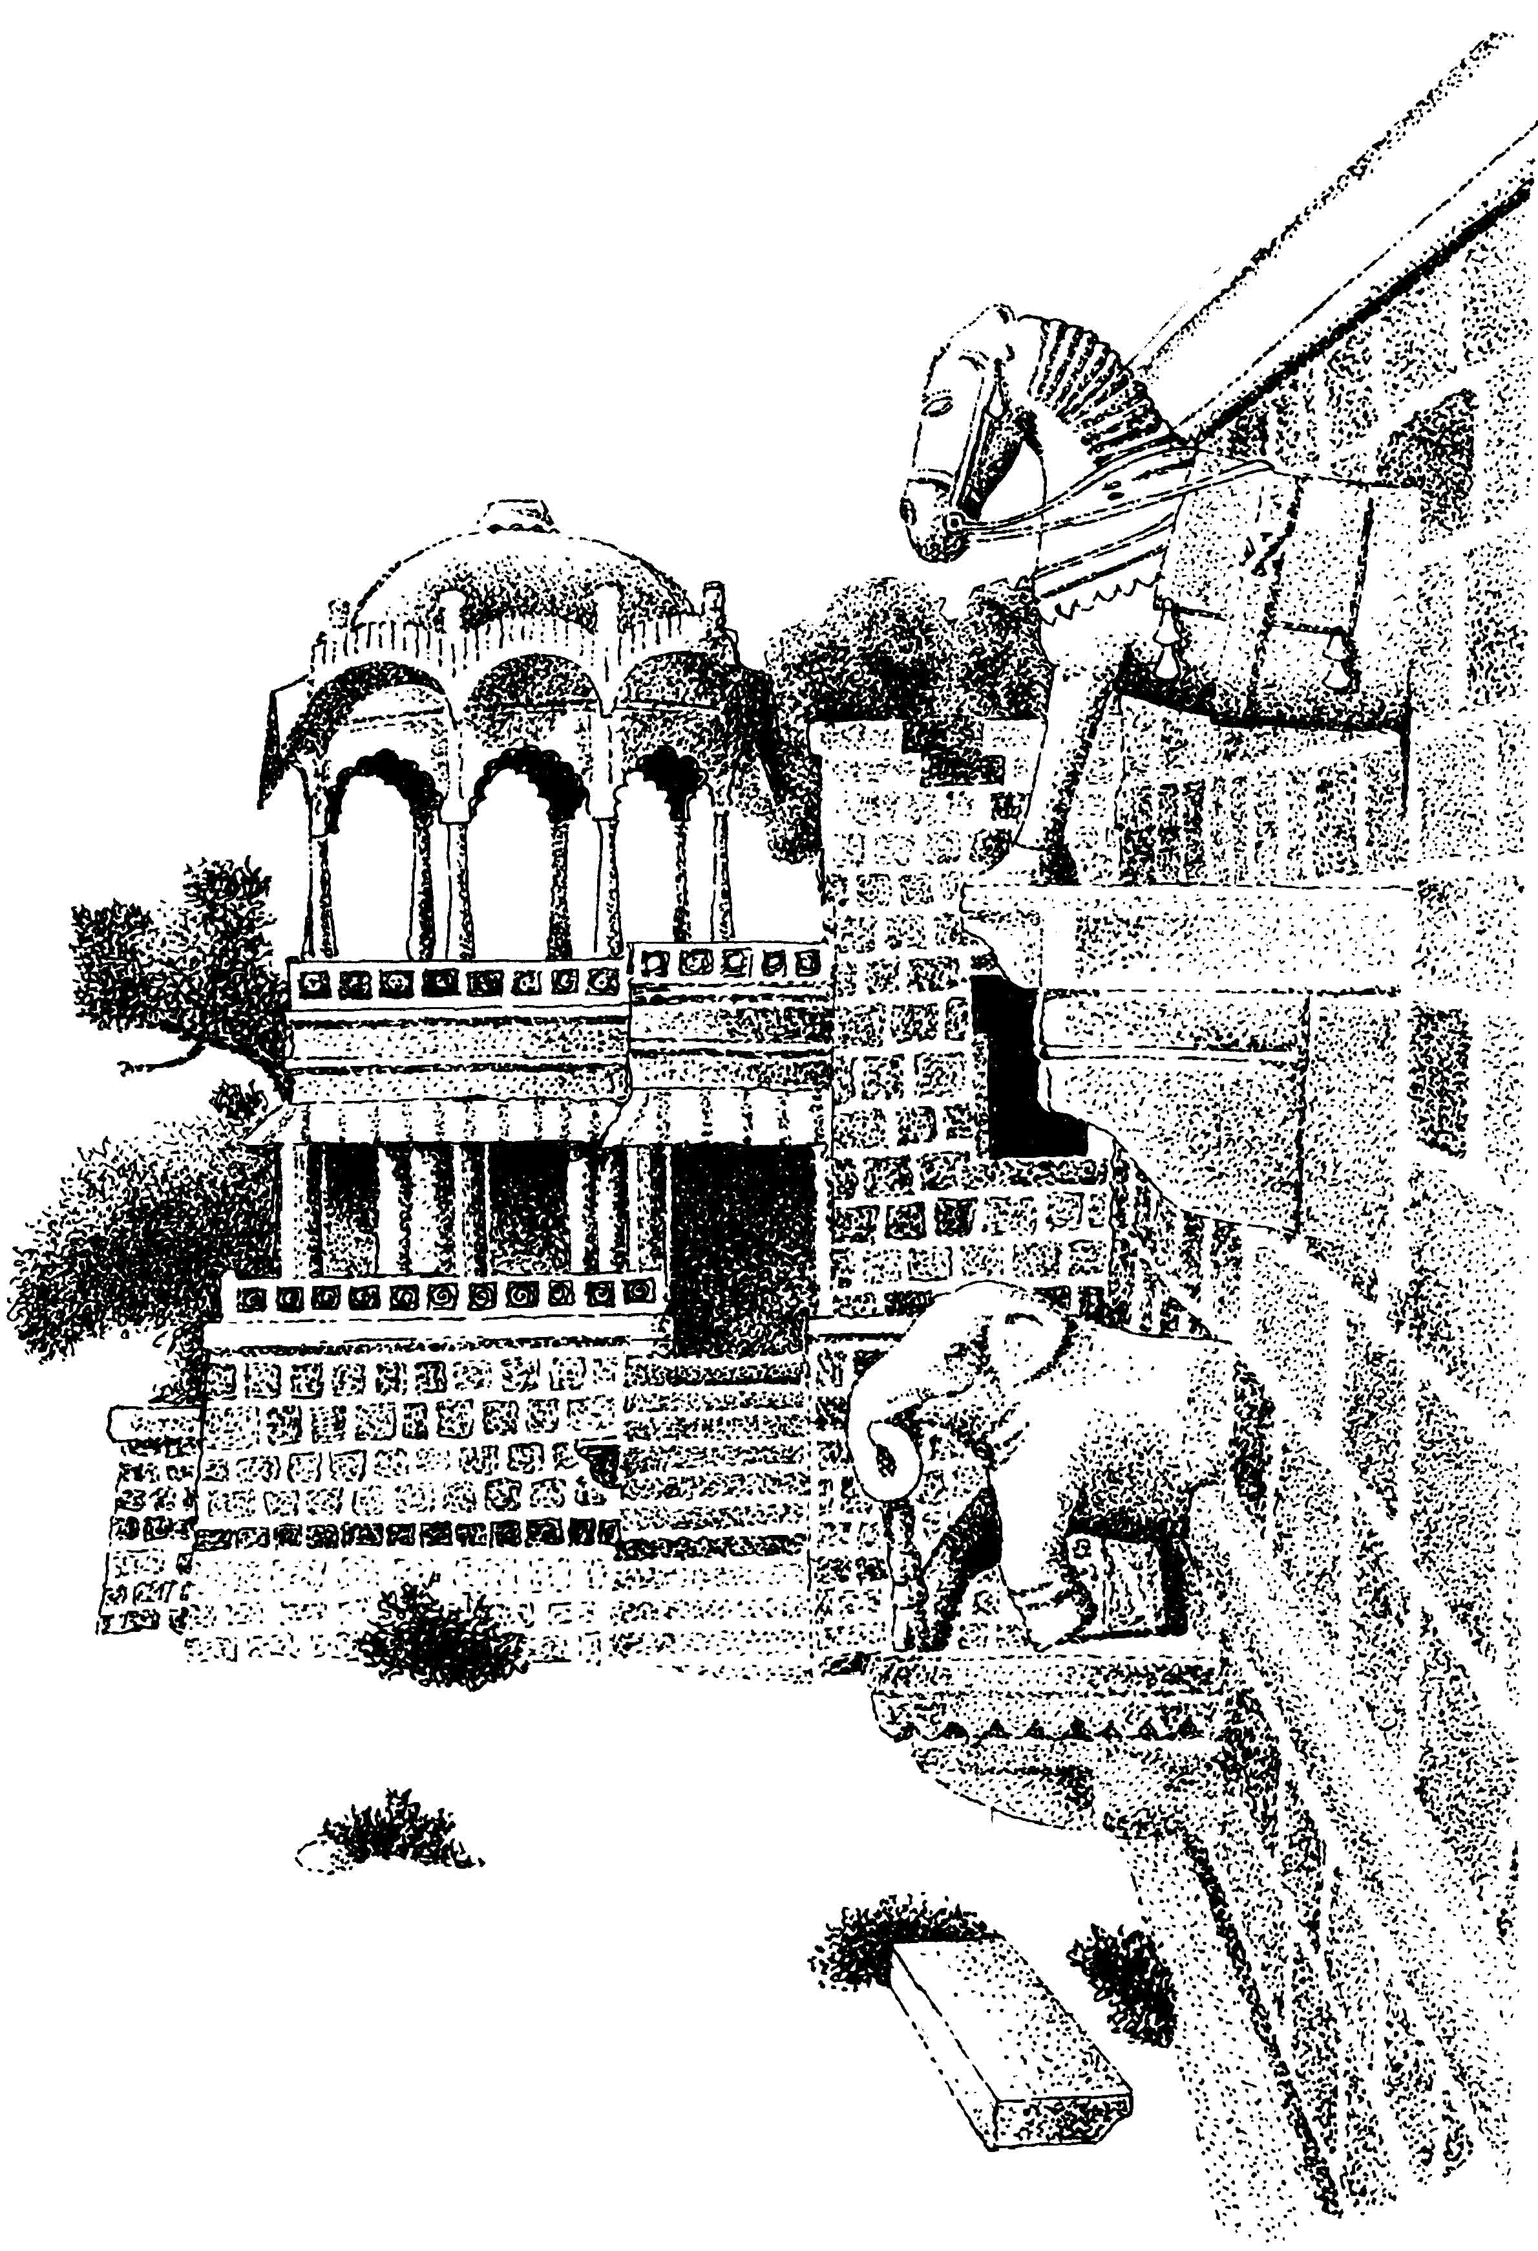
WATER
HARVESTING
SYSTEMS IN INDIA
Traditional
THERE ARE VARIOUS
METHODS OF WATER HARVESTING
EXISTING IN INDIA.
THE MAIN COMMON PECULARITIES OF ALL SYSTEM ARE :
- USE OF LOCAL RESOURCES AND TECHNOLOGY
- COMMUNITY BASED OPERATION
COMMUNITY DRIVEN
DE-CENTRALISED WATER MANAGEMENT
- CONSERVATION AND DISCIPLINED USE OF NATURAL RESOURCES

Slide 25
Why THEY WENT OUT OF USE?
INCREASE IN HUMAN AND LIVESTOCK POPULATION
WATER EXTRACTION TECHNOLOGY
CHANGED PARADIGM OF DEVELOPMENT
STATE TAKEOVER OF COMMUNITY FUNCTIONS
CREATION OF DEPENDENCY SYNDROME
DISINTEGRATION OF COMMUNITY INSTITUTIONS
PEOPLE LOST INITIATIVES AND CREATIVITY
NEGLECT OF TRADITIONAL SYSTEMS

Slide 26
REVIVAL OF SYSTEMS
USING INDIGENIOUS KNOWLEDGE
INTERVENTIONS UNDERSTANDING TRADITIONAL SYSTEMS AND USE OF INDIGENIOUS KNOWLEDGE
MOBILISATION OF COMMUNITY AROUND LAND, WATER, AND FOREST
PARTICIPATION IN REJUVENATING OLD STRUCTURES AND CONSTRUCTION OF NEW STRUCTURES
CREATION OF NEW VILLAGE LEVEL AND RIVER BASIN INSTITUTIONS

Slide 27
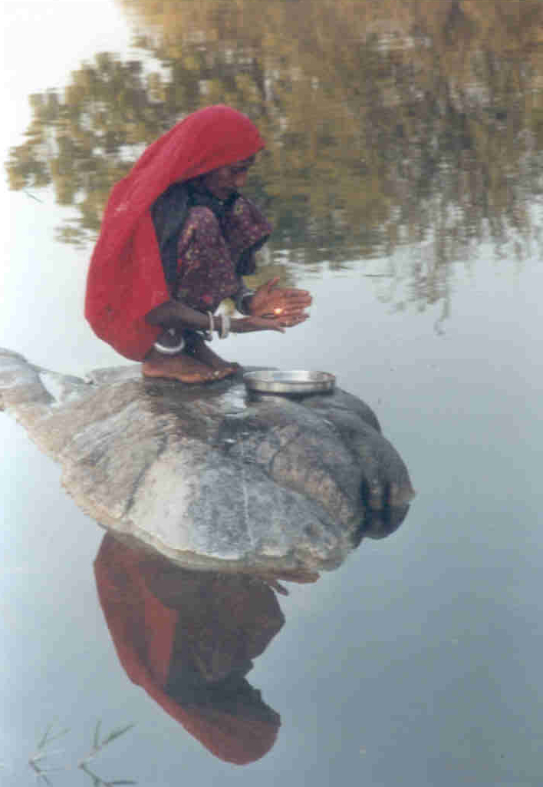
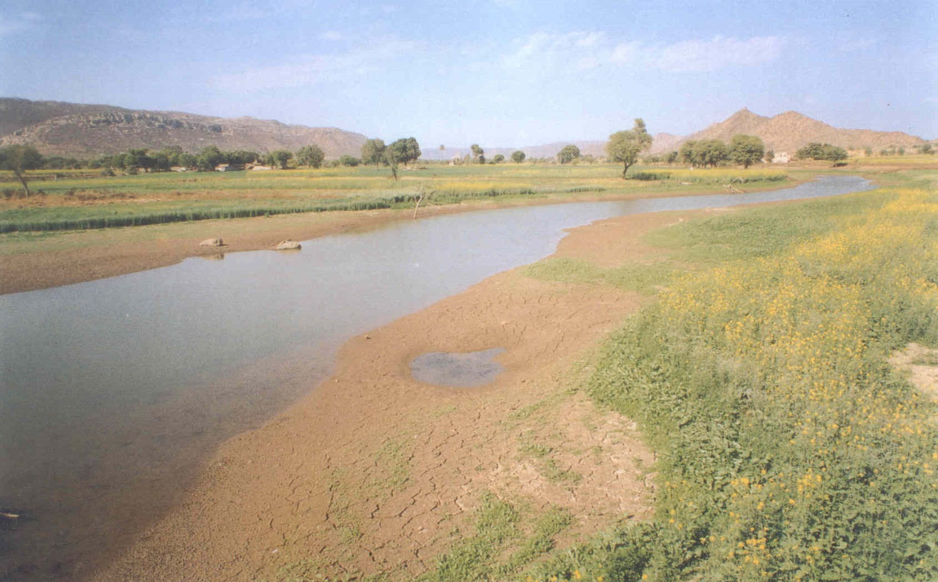
R. Arvari

Slide 28
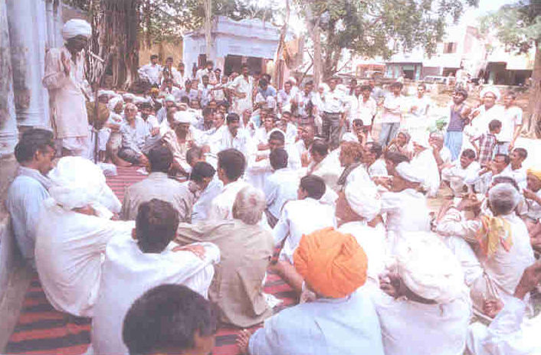
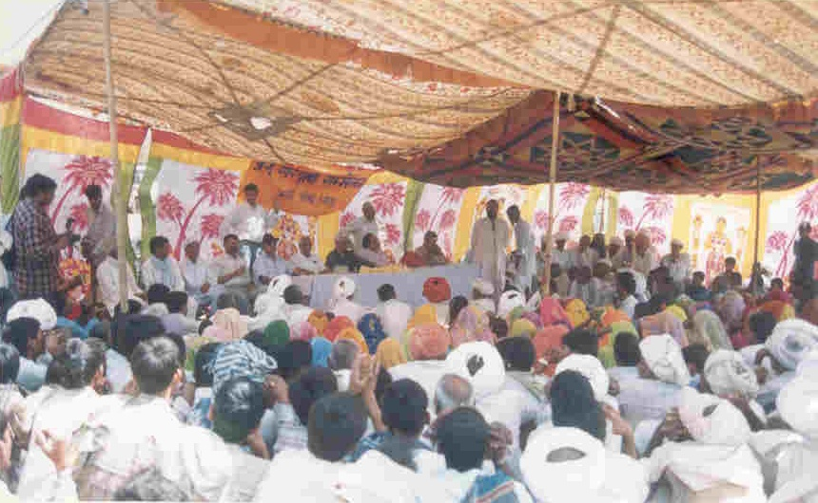
The River Basin Organization
Water Demand side management
Rules are framed about issues of water conservation and utilization, and forest conservation.

Slide 29
11 ASPECTS OF The River Basin Org.
Framing of rules regarding direct irrigation from the Bhagani river and the wells.
Framing of rules regarding crops and cattle feed.
Rules to first fulfill local needs with crop production.
No sale of water and conservation of fishes in the river.
Restriction on the sale of land and the efforts to reduce the need to sell land.
Making the whole river area green, ban mining and restrict extended grazing by nomadic grazers.
Restrictions on hunting of animals and illegal cutting of trees.
Revive traditional methods of water and forest conservation.
Prevent over exploitation of water and promote water conservation work.
Establish an active system of the management of the river.
Define and redefine the role of the village communities.

Slide 30
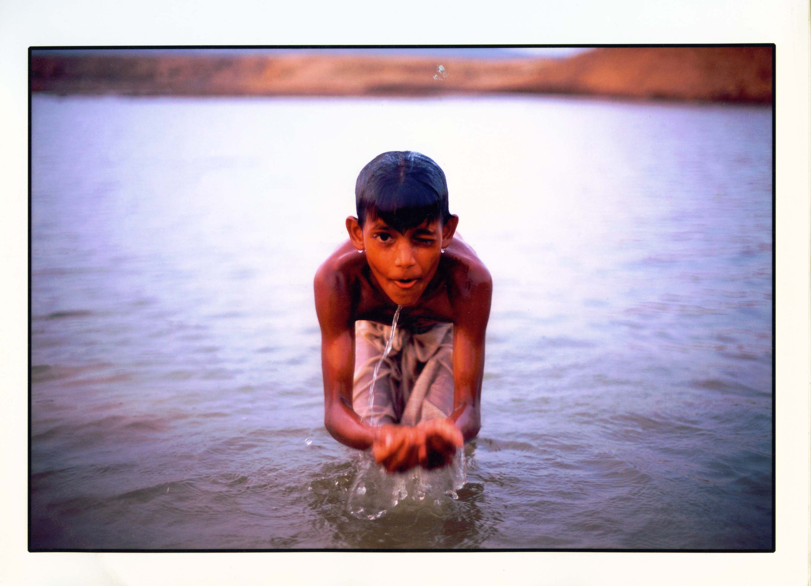
BLUE brought HAPPINESS

Slide 31
….That
is how
BLUE
brought
CHANGE

Slide 33
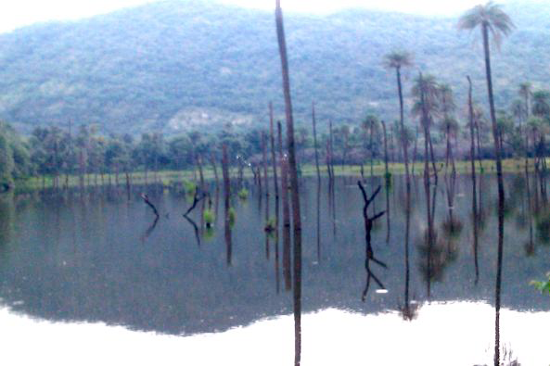
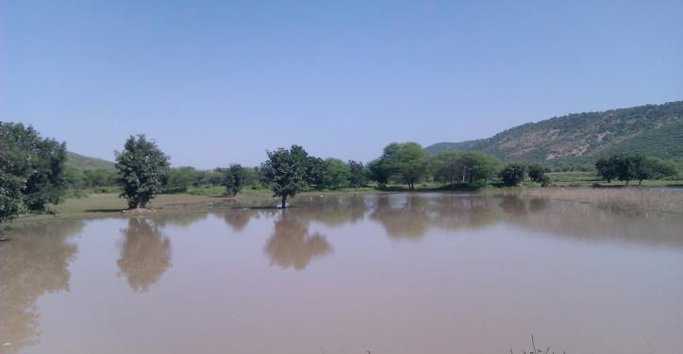
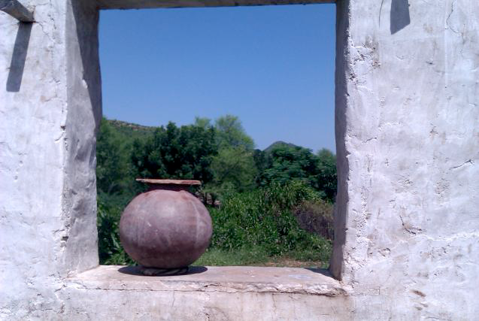
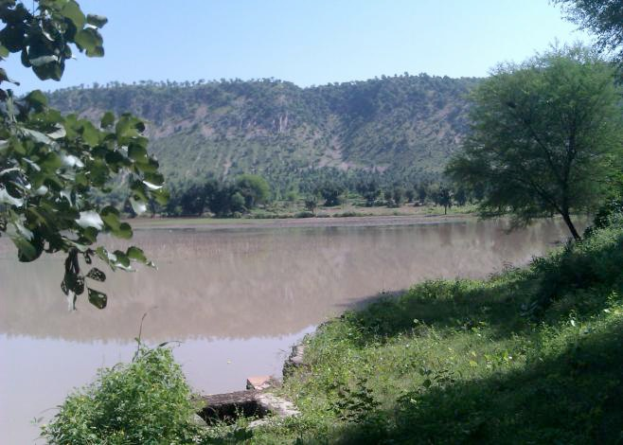







Water interventions and bodies revived & built by the Villagers – over 10,000 such structures to date

Slide 35
Thank you…

